Slide 1
$$1×ν$$
Notes:
You can think of them as the gates of a spill-way as it controls the outflow of the network.
Just like a spillway, this gating is not discrete but continuous (between 0 and 1)
But more importantly, it controls the gradient coming back, and therefore controls which parts of the network gets updated.
This gating is linear, but Future experiments could look into the potential of gating inside the network before non-linear activations
If anyway is looking for projects idea.
(Although I’m guessing this is what the authors are looking into now)
It would be nice to also be able to include the task information at the entry of the neural network…
Ideally in the form of a context vector, one that would increase in length with the number of distinctions
but I found this be problematic for CL setup

Slide 2
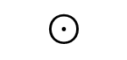

$$⊙$$
$$S$$
Notes:
-Long output vector is a extreme classification problem
- The authors train their network on output of size 1000 to be over their needs
But this is not dealing with an unknown number of classes
Experimental setup is of fixed output length, meaning we know the number of classes/tasks ahead of time
-Dynamic Neuromodulation Meta-Learning as a project
- No longer compatible in the Meta-Testing phase
Reveals that network bottleneck is actually a source of catastrophic forgetting

Slide 4
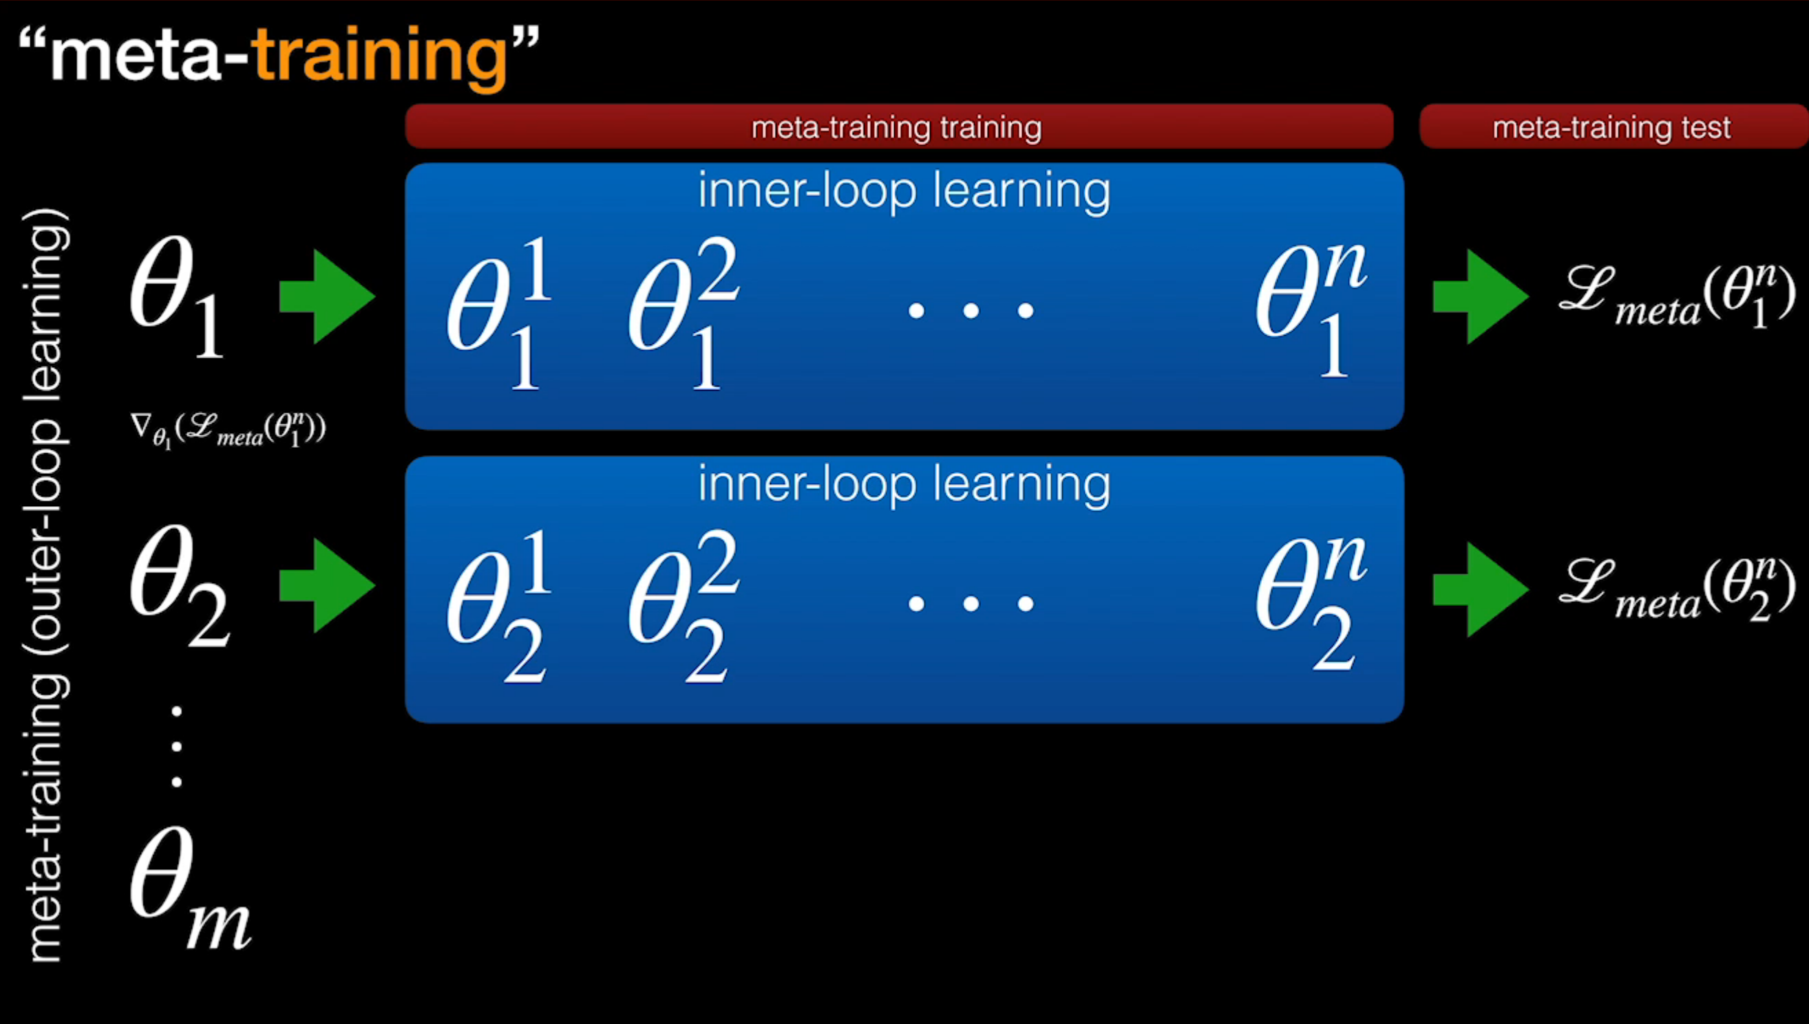

Slide 5
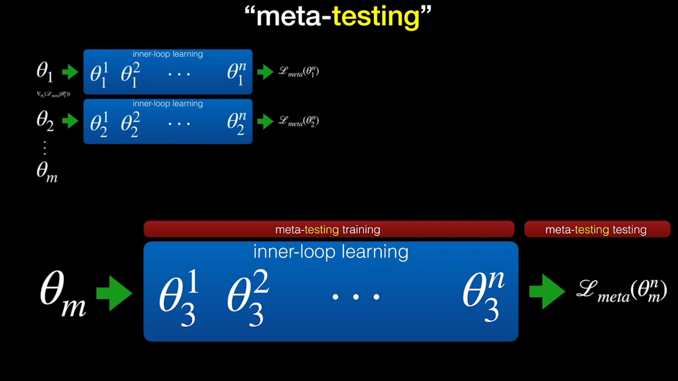

Slide 6
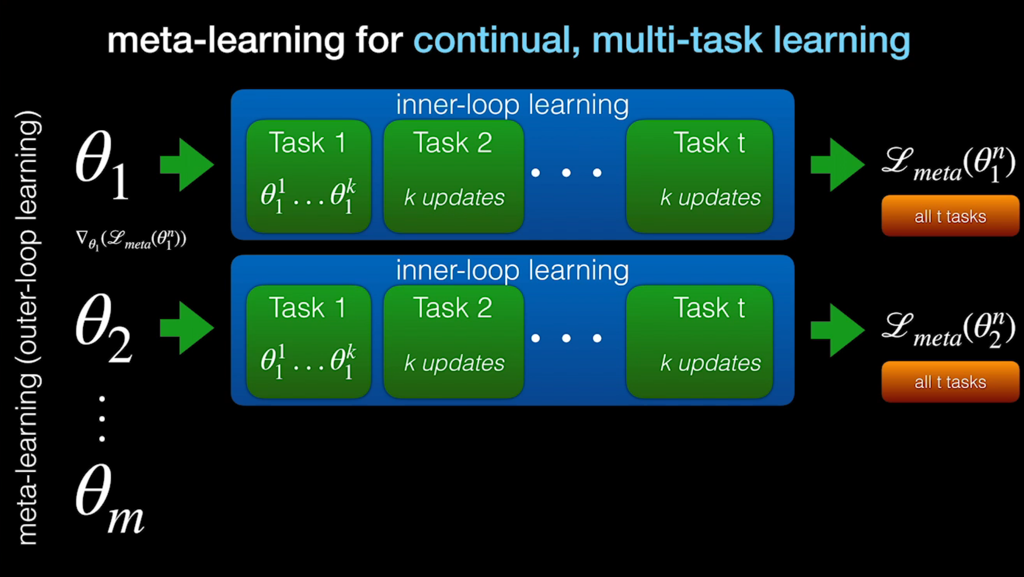

Slide 7
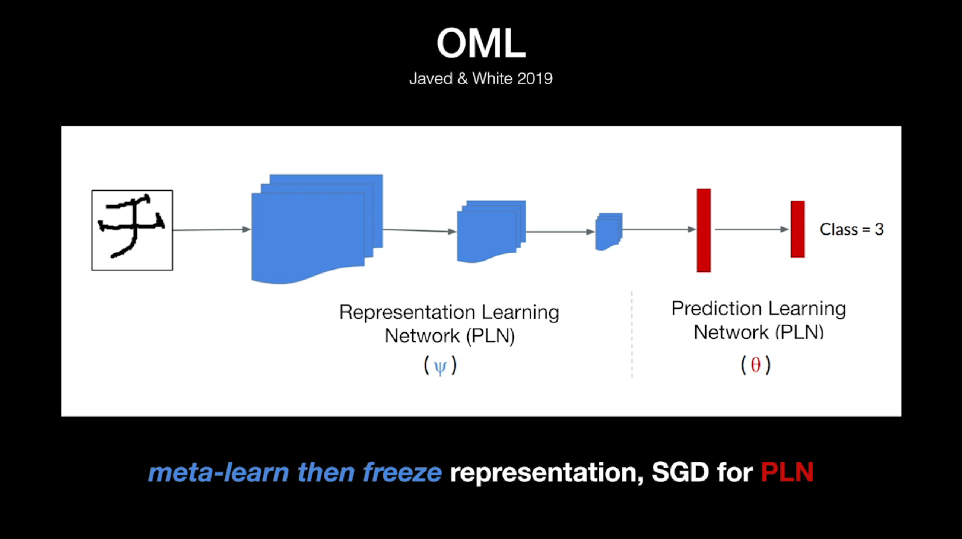

Slide 8
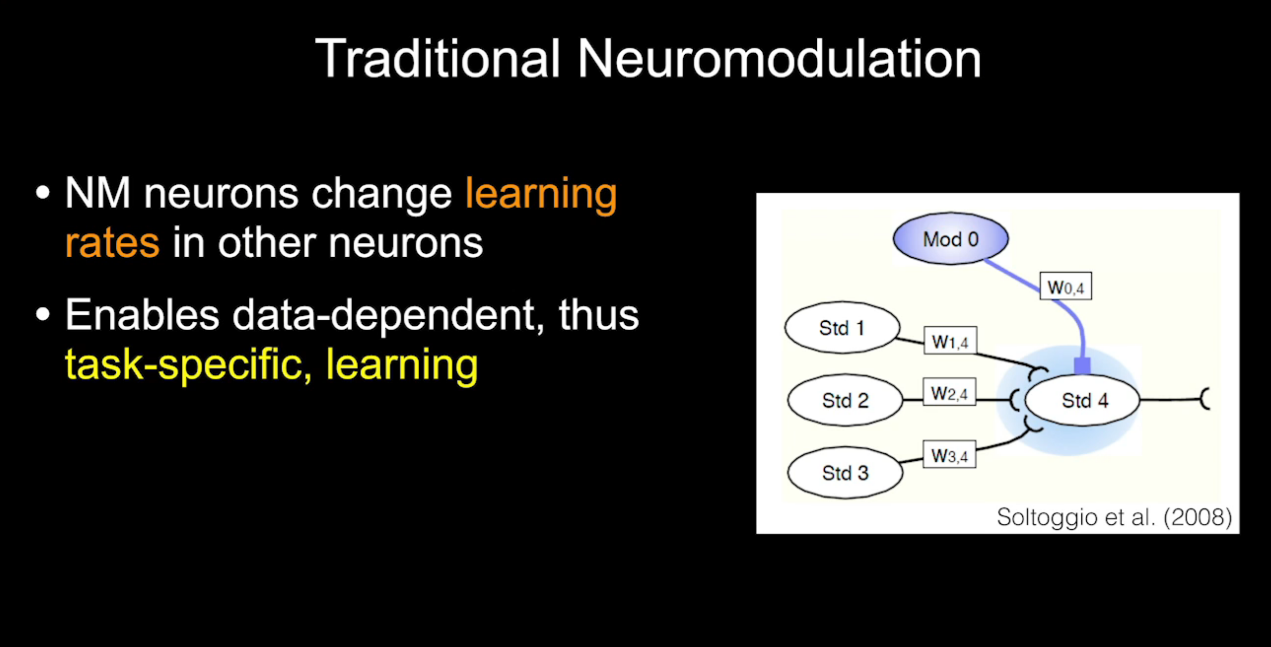

Slide 9
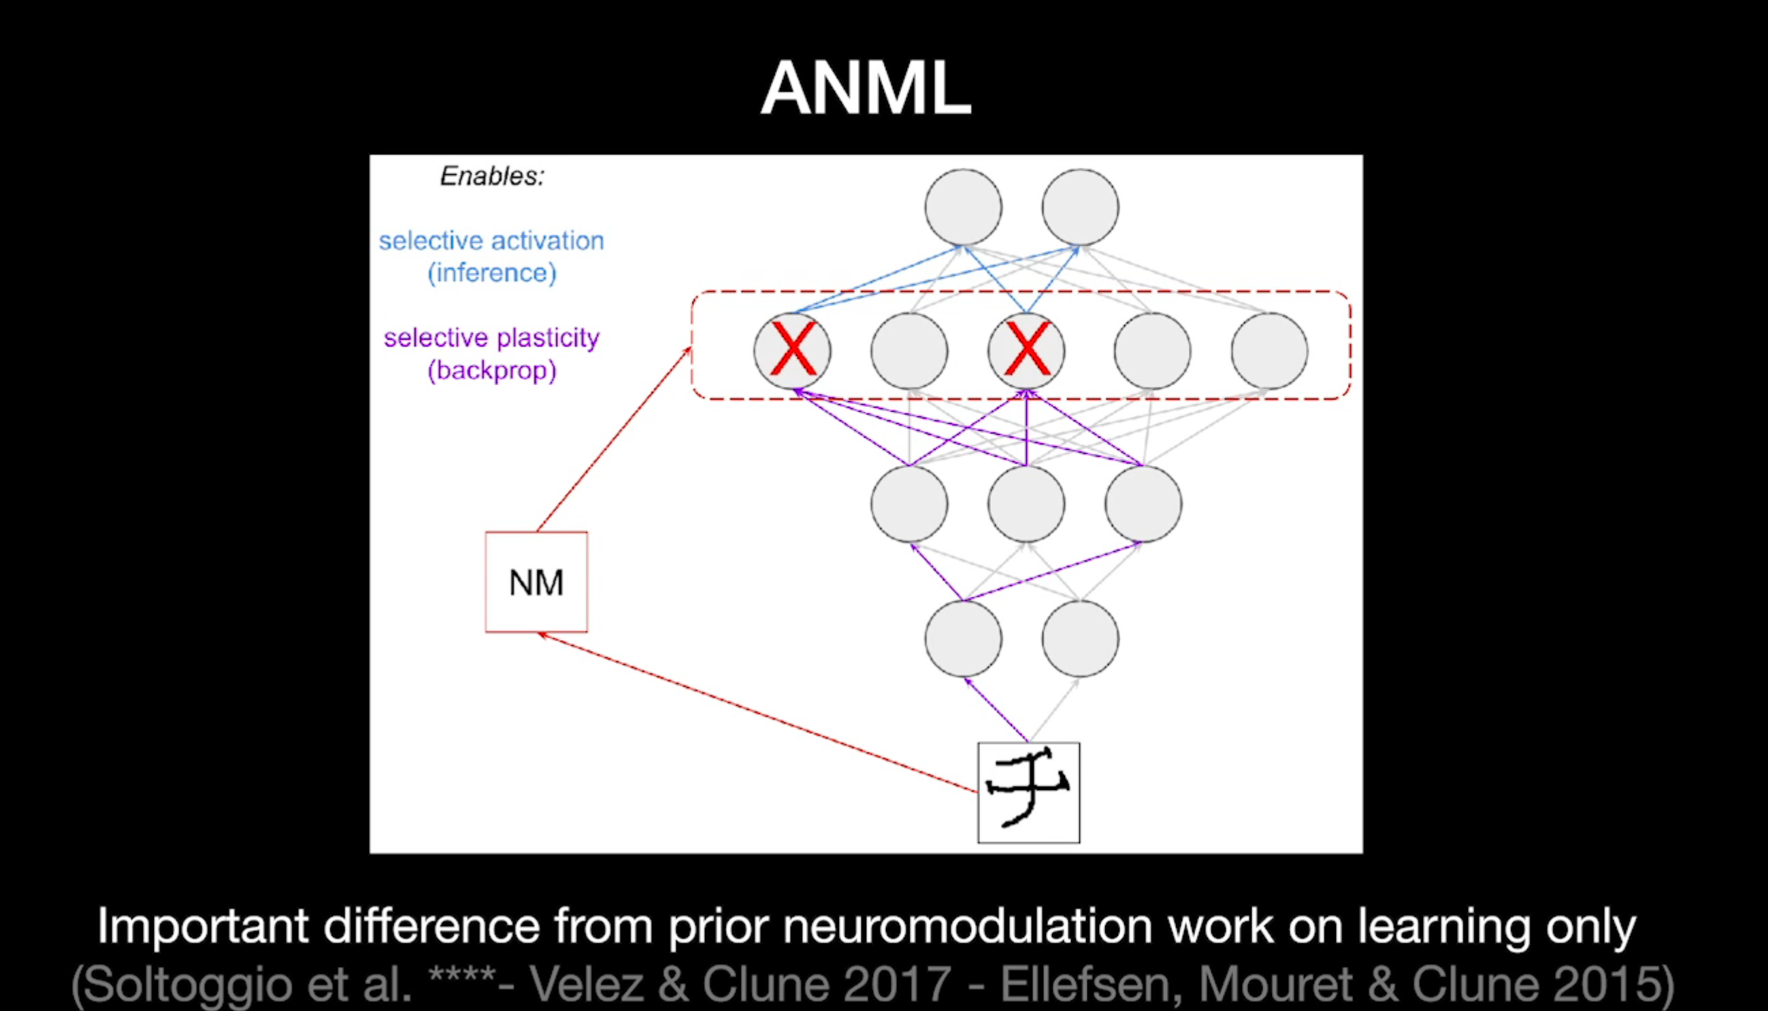

Slide 10
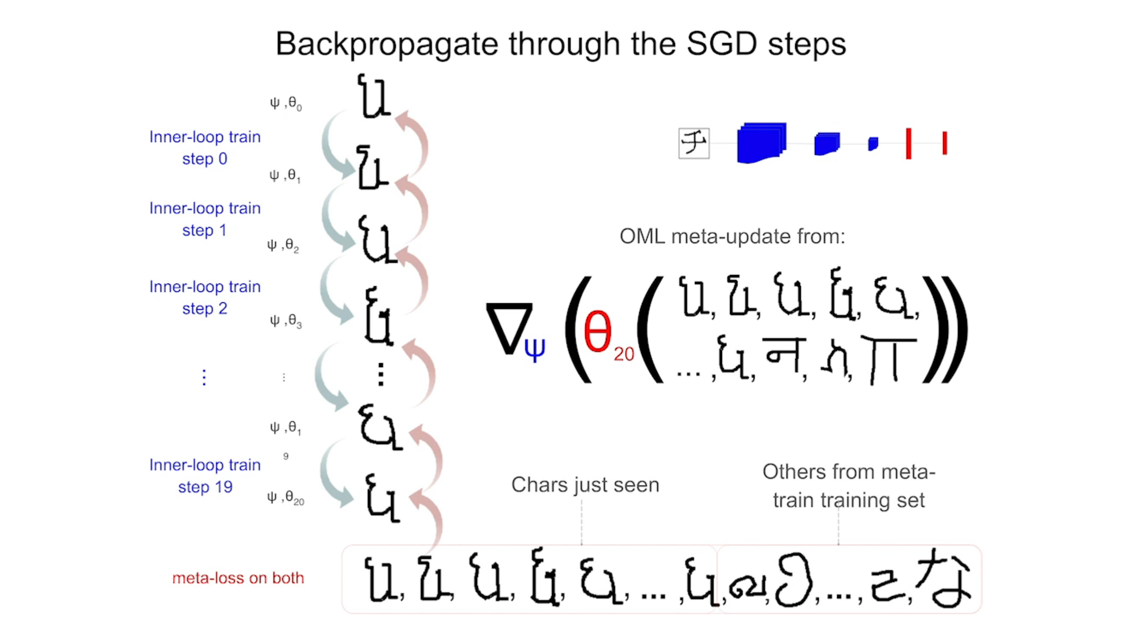

Slide 11
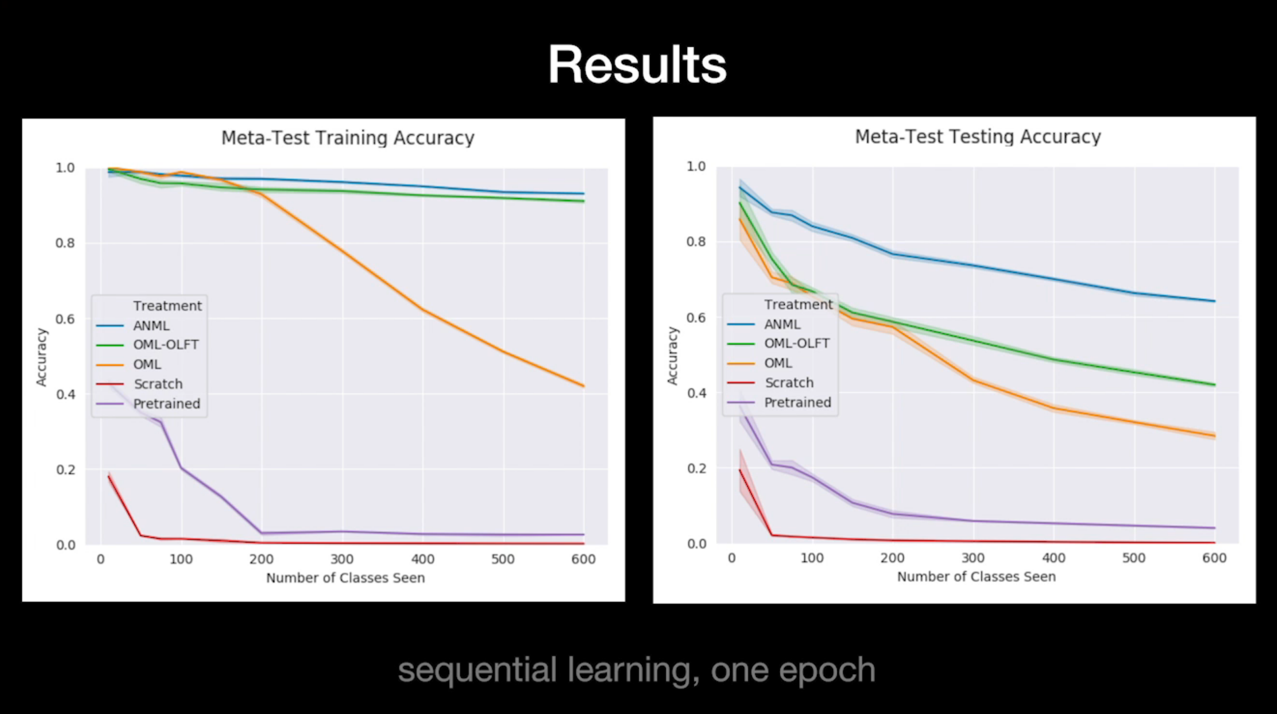

Slide 12

Structured SVM loss if Meta-Learn new class decisions

Slide 13

GLOBAL VS LOCAL ACCURACY

Slide 14
GLOBAL VS LOCAL ACCURACY

